Slide 1

Improving Patient’s Assessment of Their Migraine
Erin M. Buchanan, Ph.D.
Harrisburg University of Science and Technology

Slide 2



Research Team
Addie Wikowsky, Clinvest Research
Heather Manley, Clinvest Research
Jim Sly, Clinvest Research
Ryan Cady, Clinvest Research
K. D. Valentine, MGH

Slide 3
Outline
Migraine Background
Development of the FAMS
What do patients care about?
Creation of a PRO: the FAMS
Assessment of the FAMS
Development of Phone App Tracker
Personalized patient reports
Confirmation of the FAMS
Future Directions
Assessment of patient reports
Improvements for shared decision making

Slide 4
What is a headache?
Head pain that is unpleasant, ranging from mild to severe
Pressure and aching
Triggers include stress, anxiety, sinus
Nearly everyone experiences headache
Migraine Background

Slide 5
What is migraine?
Often characterized as an “attack”
Moderate to severe pain
Comorbid with visual disturbances, nausea, vomiting, sensitivity to light/sound/smell, auras
~12% of the population has experienced migraine
Migraine Background

Slide 6
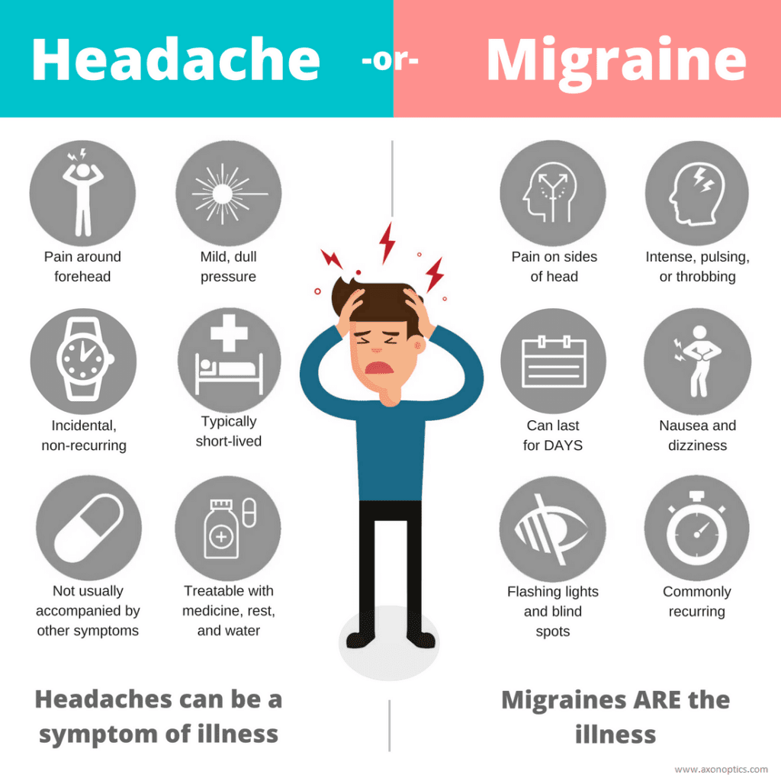
Migraine Background

Slide 7
Fast Facts
3rd most prevalent illness in the world
A woman’s illness
Often 1-2 attacks per month, others are chronic with 15+ per month
Serious impacts on work, family, and daily life
Migraine Background

Slide 8
Why is there a need?
Do we really need another scale?
Development of these scales is often Doctor/Researcher oriented
Focus, Readability, etc.
Scales are often designed for only one facet of migraine
Cost of scales can be prohibitive
Number of therapeutic options is on the rise
Development of the FAMS

Slide 9
What do patients care about?
Developed a semi-structured interview:
Subject Matter Experts (Clinvest Team, Patient Advocate, Migraine Specialists)
Mix of open ended and ranking type questions
Thematic domains of pain, productivity, social with the opportunity for others
Sample:
10 patients with migraine
80% Female
47.6 years old (SD = 13.3)
70% Chronic Migraine
Development of the FAMS

Slide 10
What do patients care about?
Two main results:
Rating of importance for our preselected themes
Thematic analysis of open-ended responses
Development of the FAMS

Slide 11
Phase 1 – Patients tell us what matters
Development of the FAMS

Slide 12
Development of the FAMS

Slide 13
Creation of a PRO: the FAMS
Scale Creation
Team brainstormed ~ 200 questions assessing the 12 themes
Normal Functioning: My activity level has increased because my migraine attacks have improved.
Social: I have been able to schedule events with family and friends, which means I am improving.
Frequency: I now have fewer migraine attacks.
Sample:
100 patients with migraine
84% Female
38.9 years old (SD = 13.3)
70% chronic migraine
Development of the FAMS

Slide 14
Creation of a PRO: the FAMS
Theme | Original Questions | High Loadings | Important to Patients
Associated Symptoms | 13 | 8 | 7
Concentration | 9 | 7 | 6
Doctor | 13 | 13 | 13
Education | 15 | 10 | 10
Financial/Insurance | 17 | 16 | 15
Frequency | 19 | 17 | 17
Medication/Financial | 22 | 14 | 13
Normal Functioning | 27 | 27 | 19
Pain | 17 | 13 | 13
Productivity | 24 | 17 | 10
Self-Worth | 14 | 12 | 6
Social | 20 | 16 | 8
Development of the FAMS

Slide 15
Creation of a PRO: the FAMS
We then examined the “good” questions with a larger sample to create our finalized scale.
Sample:
200 patients with migraine
84% Female
49.9 years old (SD = 13.2)
80% chronic migraine
Development of the FAMS

Slide 16
Assessment of the FAMS
The FAMS is a set of scales:
Research (18 items)
Clinical (9 items)
Supplemental (9 items)
Psychometrics appear to support reliability, convergent/divergent validity, and predictive usefulness.
https://osf.io/pqmsh/
Development of the FAMS

Slide 17
Development of the Phone App Tracker
Develop an application to track migraine with the FAMS
Provides personalized feedback to patients to share with providers for enhanced decision making
Solicit patient feedback on the application
Further assess the FAMS for suitability for all types of patients
Development of the Phone App Tracker

Slide 18
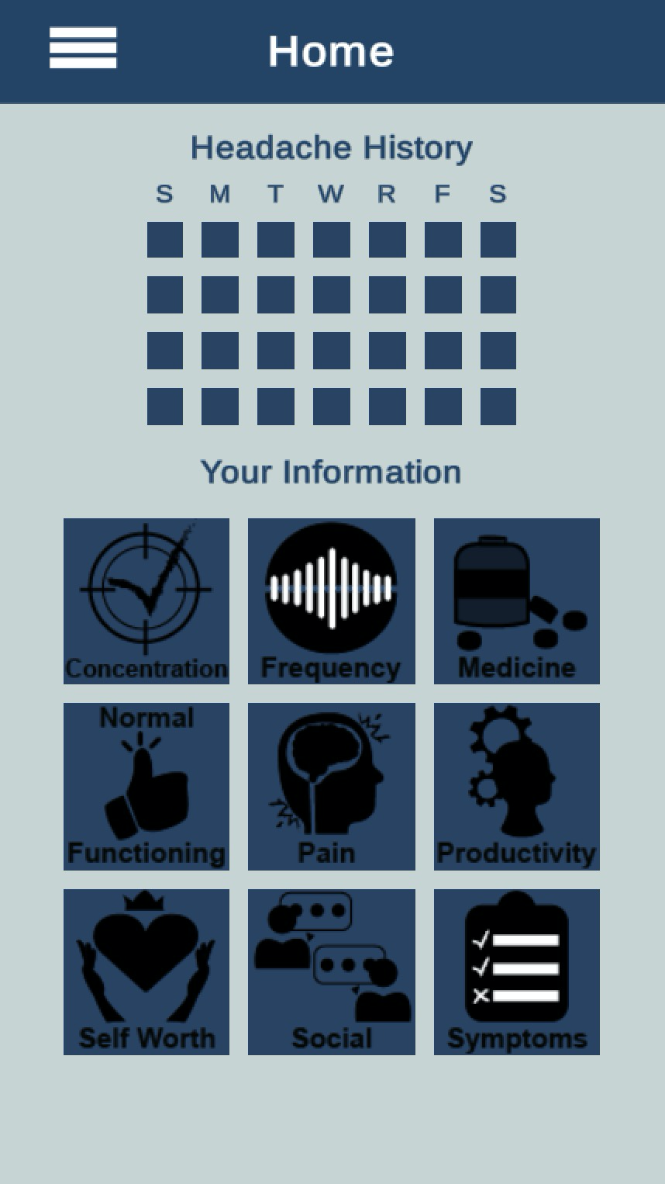
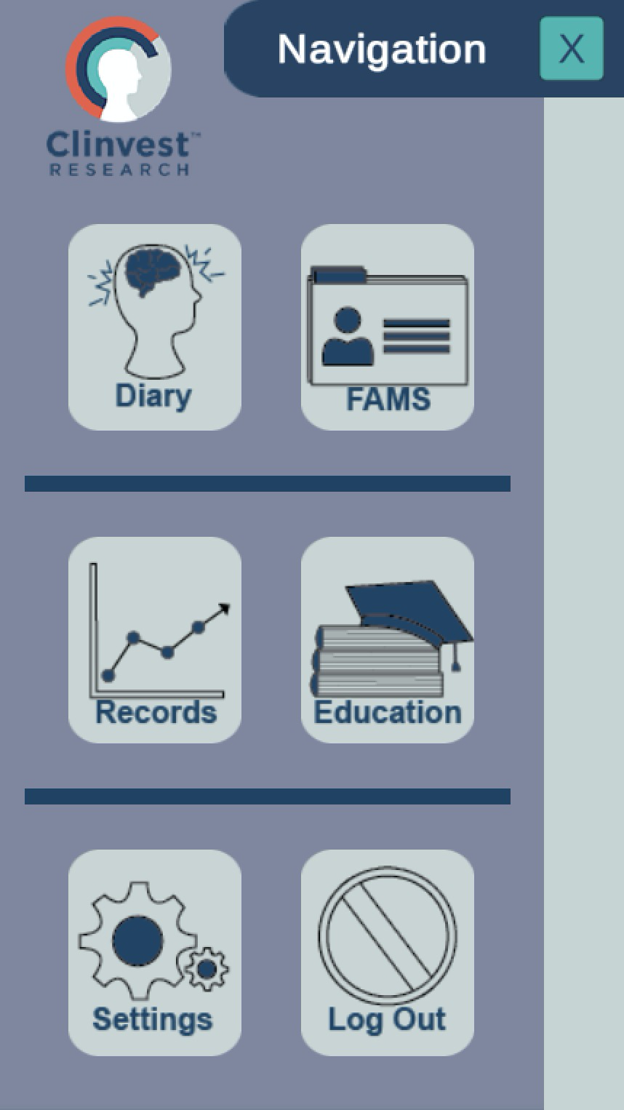
Development of the Phone App Tracker

Slide 19
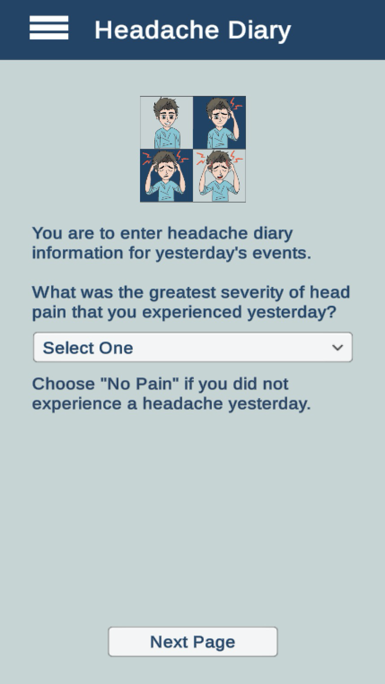
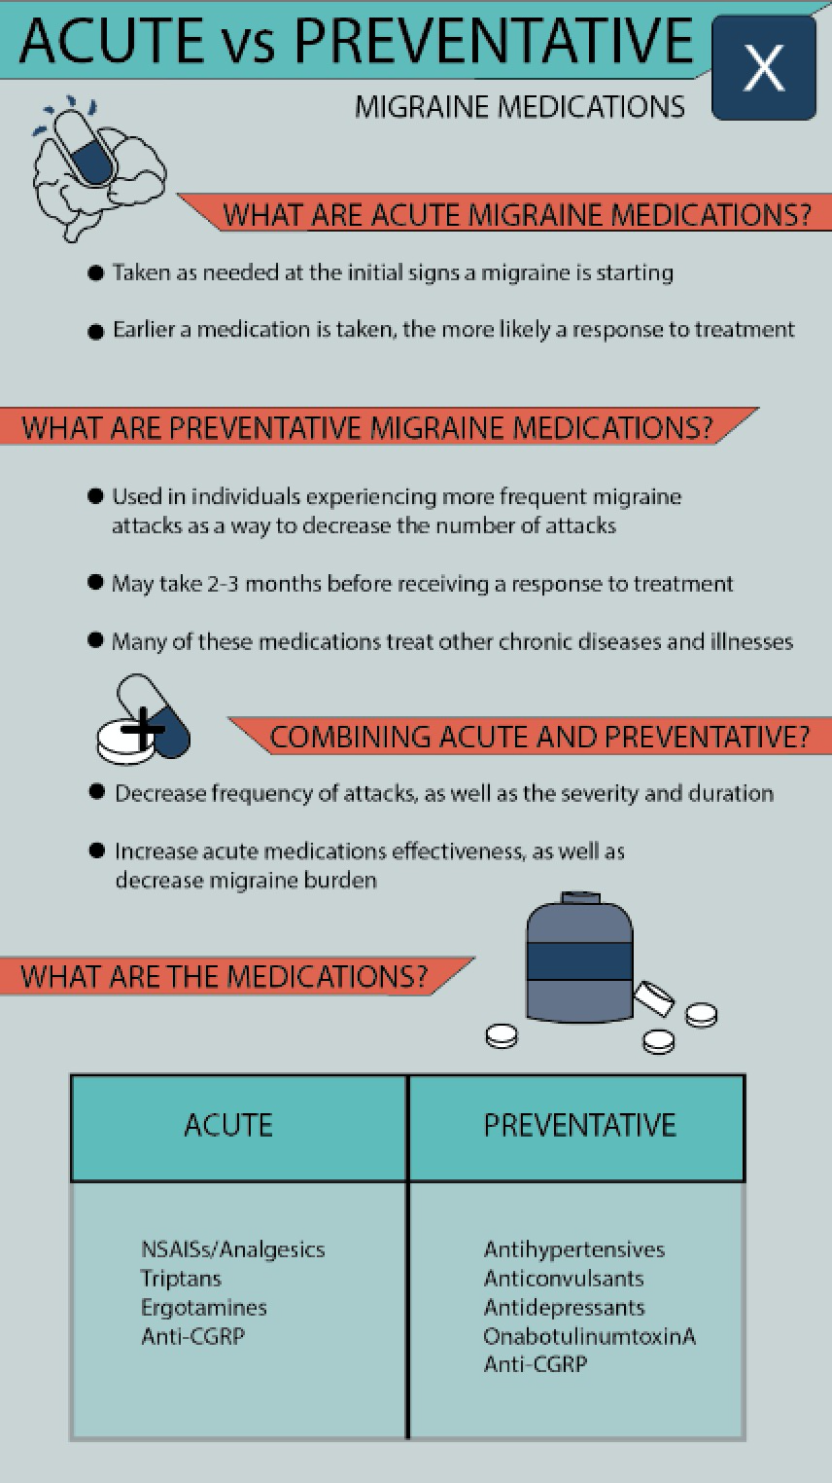
Development of the Phone App Tracker

Slide 20
Patient Feedback
The app has received positive initial feedback from patients
Appears cleanly designed
Easy to navigate
User friendly
Well designed for the target audience (i.e., colors are muted for light sensitivity)
Development of the Phone App Tracker

Slide 21
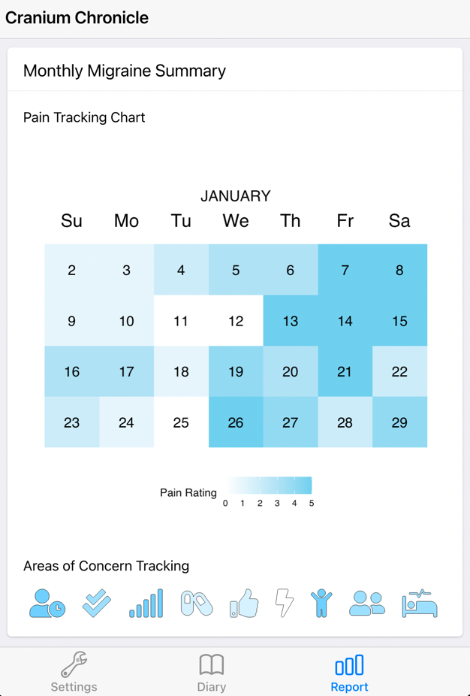
Practical Realities
Updated app for long-term development and maintenance
Use software that allows for customization
Design and implement customized reports
Development of the Phone App Tracker

Slide 22
Confirmation of the FAMS
Ongoing daily dairy data collection to garner a large sample for testing chronic and episodic migraine separately
19 chronic patients
42 episodic patients
80 total FAMS entries
Combined with previous data for current assessment (253 chronic, 110 episodic)
Study modifications
Development of the Phone App Tracker

Slide 23
Confirmation of the FAMS
Overall results indicate room for improvement on original scale
Investigation indicates the reverse coded items may be an issue
Separate models for episodic and chronic patients indicate similar scale functioning for each subset of patients
Development of the Phone App Tracker

Slide 24
Confirmation of the FAMS
An interesting finding:
The items that indicate the poorest fit are all related to head pain days/frequency
My number of severe head pain days has decreased.
I now have fewer migraine attacks.
Overall, my head pain has decreased.
My number of head pain days have decreased.
Development of the Phone App Tracker

Slide 25
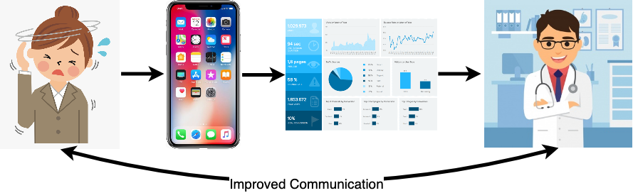
Future Directions
Future Directions

Slide 26
Future Directions
Create Digital Health Platforms:
Provided for researchers, patients, and providers
Use qualitative data and natural language processing to summarize most bothersome symptoms and other concerns
Use quantitative data to provide real-time summarized risk scores, along with simple tracking visualizations
Future Directions

Slide 27
Future Directions
Assess Digital Health Platforms:
Do patients and providers use these tools?
Does their use improve perceived shared decision making and satisfaction?
Can we improve outcomes beyond just pain and frequency?
Future Directions

Slide 28
Summary
Migraine is a multi-faceted illness with many factors to consider!

Slide 29

Thanks for listening!

